Slide 1
Memory Leaks in Blink
kouhei@
Photo © 2011 J. Ronald Lee.

Slide 2
Agenda: Memory Leaks
Why should we care?
Our work in Tokyo FasterDOM team
Deep memory profiler
Blink leak detector
Real world leaks
Summary

Slide 3
Why should we care about leaks?
Memory usage of Chrome is a popular user complaint.
Especially on mobiles!
Leaks are expected to be the major cause of memory bloat.

Slide 4
Popular myth
Renderer process die often, so we can have much leak as we want.

Slide 5
Wrong!
Long running renderer process
“Web apps” are open for a long time
Gmail, SNS, etc.
Chrome Apps/Extension/Background Pages
Single renderer: Android WebView apps

Slide 6
Agenda: Memory Leaks
Why should we care?
Our work in Tokyo FasterDOM team
Deep memory profiler
Blink leak detector
Real world leaks
Summary

Slide 7
Tokyo memory efforts
“Faster DOM” team in Tokyo is working on reducing renderer memory.
Deep Memory Profiler: dmikurube@
Leak detector: kouhei@ and hajimehoshi@
Real world leak: hajimehoshi@
Oilpan

Slide 8
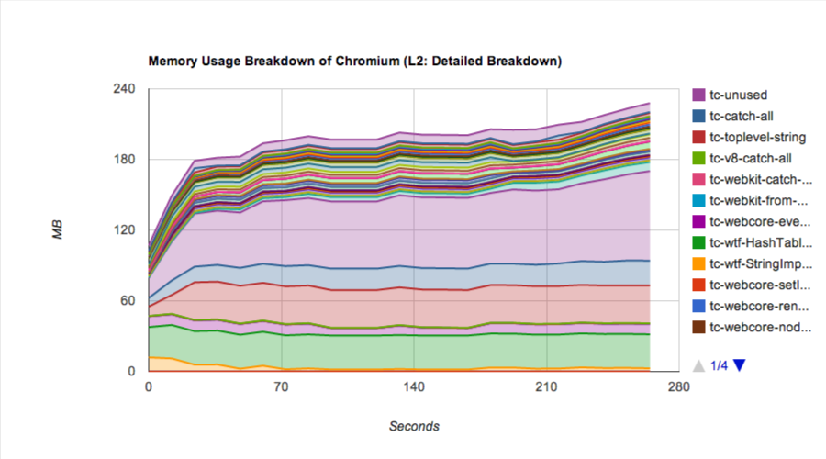
Deep Memory Profiler (dmprof)
Provides in-depth view of Chromium/Blink heap allocations
Not only leaks, but bloat
Customizable how to breakdown
http://dev.chromium.org/developers/deep-memory-profiler

Slide 9
Deep Memory Profiler (dmprof)
Useful for first-step investigation:
High level overview of memory issues.
ex.) What obj is consuming all the memory.

Slide 10
Blink Leak Detector
Detects WebCore::Document leaks from LayoutTests
How to use:
content_shell --dump-render-tree --enable-leak-detection
run-webkit-tests --enable-leak-detection
Watch waterfall

Slide 11
How does the leak detector work?
Count number of documents
Run a LayoutTest
Force GC
Count number of documents again
if (diff > 0) report error.

Slide 12
Blink leak detector
Current progress:
2013Q2: 1300 leaks out of 30000
2014Q2: 100 leaks out of 30000
The hard part: Long persisting leaks leads to codes relying on leaks.
e.g.) SVG properties, editing, fonts, extensions, etc.

Slide 13
Real world leaks
We wanted to know how the current leak impact users.
+ Specifically what leak bugs have impacted users.
Summary:
We navigated WebView to alexa top N websites and found that 294KB heap and ⅓ WebCore::Document is leaking per website.

Slide 14
Real world leaks: Method
We investigated memory usage of WebView while visiting top N web sites.
WebView uses single renderer instance,
Auto navigate WebViewShell using adb input
Trigger GC aggressively

Slide 15
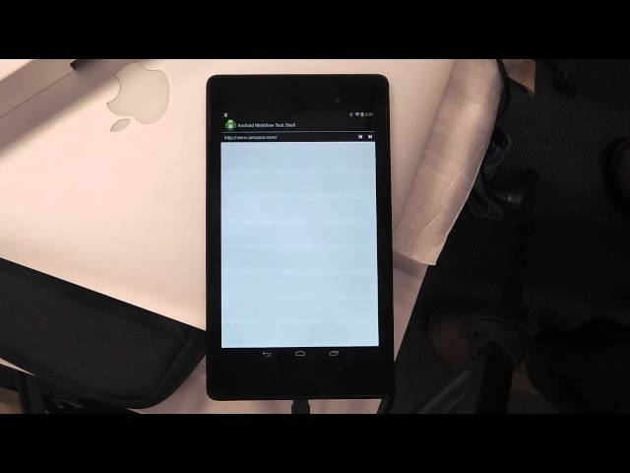

Slide 16
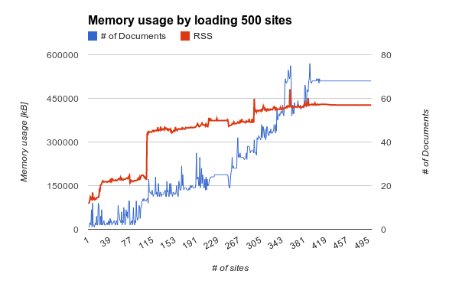
First attempt

Slide 17
Memory usage jumps
when loading certain websites
Jumps!
naver.com
globo.com
wordpress.com
Flaky!?

Slide 18
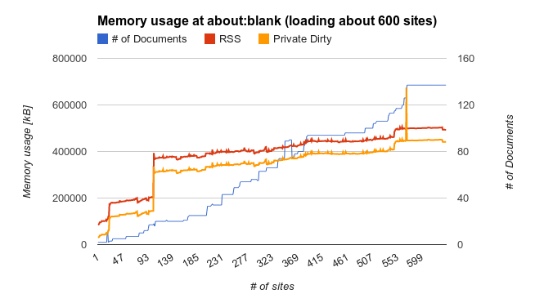
Measure at about:blank

Slide 19
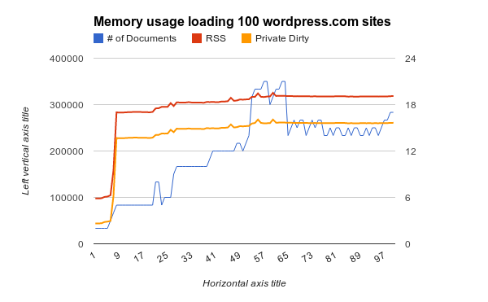
What’s going on at wordpress.com?
wordpress.com
top page
Notes:
random website *.wordpress.com

Slide 20
Minimized wordpress.com
<link rel="stylesheet" href="./noticons.css">
<body style="background-image:url(white.png)">
<p style="font-family:'Noticons';">a</p>
</body>
WOFF font

Slide 21
Minimized wordpress.com
<link rel="stylesheet" href="./noticons.css">
<body style="background-image:url(white.png)">
<p style="font-family:'Noticons';">a</p>
</body>
WOFF font
Removing this part fix the leak...

Slide 22
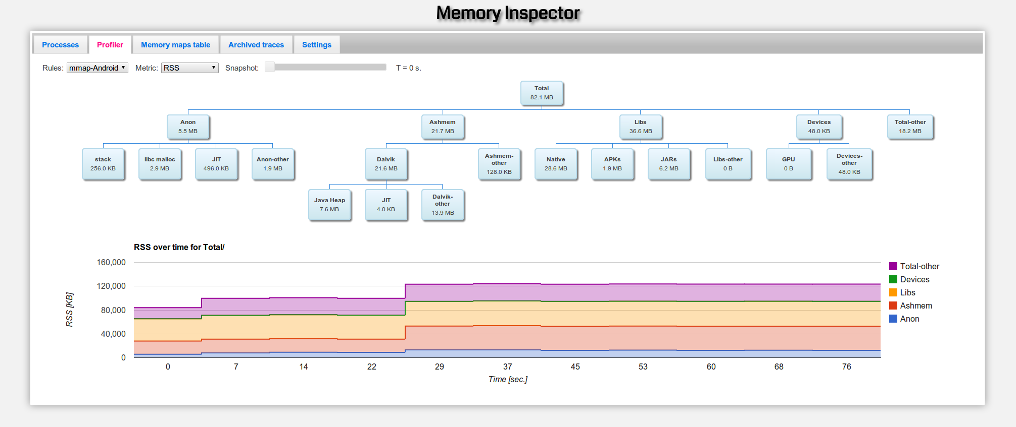
memory usage breakdown using primiano@’s tool
Ashmem is increasing!

Slide 23
What is ashmem?
Shared memory system specific to Android Linux Kernel
Can be used to annotate cache regions
Unpinned memory is held as long as system is not low on memory.
Can be pinned again if the region was not evicted.

Slide 24
Who is using Ashmem?
DiscardableMemoryAllocator wraps around ashmem.
Add Printf at using ashmem as its backend.
Region alloced for FontResource seems not released!
→ Font leak crbug.com/366533

Slide 25
Ashmem purging
However, the leaked region is ~20MB.
Too large for a font leak!
19MB was consumed by top background image.
ashmem is only purged when at system is low on memory.
We need to force purge for correct measurement!

Slide 26
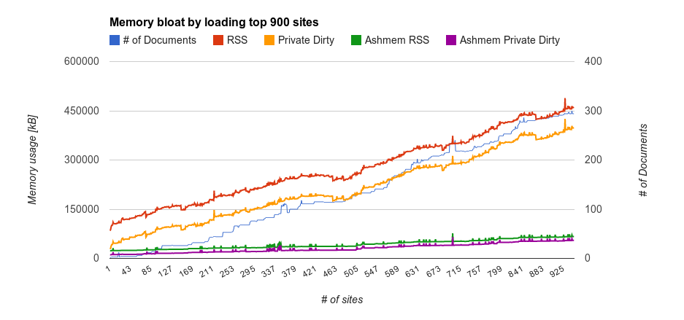
Corrected graph

Slide 27
End?
The overall (priv.dirty) memory usage is still increasing.
The average leaked mem (KB) / visit is 390KB.
WebCore::Document instances are also leaking:
294 documents are leaking after visiting 946 websites…

Slide 28
Agenda: Memory Leaks
Why should we care?
Our work in Tokyo FasterDOM team
Deep memory profiler
Blink leak detector
Real world leaks
Summary

Slide 29
Summary
We still have a lot of memory leak in Blink.
390KB heap, ⅓ WebCore::Document leak per website.
Tokyo team is investigating known leaks
SVG, ServiceWorker, Fonts, etc.
We should be careful not to introduce regressions
Keep an eye on Webkit Linux Leak waterfall.
We will contact you when we find new leaks.

